Slide 1
Stop everything! Top T-SQL tricks to a developer https://github.com/marcosfreccia/sql-saturday-689-prague
Marcos Freccia

Slide 2


Slide 3

Marcos Freccia
SQL Server DBA at Zalando SE
@sqlfreccia
sqlfreccia@outlook.com
http://marcosfreccia.wordpress.com
Data Platform MVP
MCSA DBA & DBA SQL Server 2016 – Charter
MCSE Data Management and Analytics SQL Server 2016 – Charter
SQL Server DBA for 8 years
Originally from Brazil, now living in Berlin, Germany

Slide 4
Why this session?
Most of the times we skip the basics
We focus too much on hardware and forget software
You don’t need to be a master to do that
Notes:
Why I think this session is important to you?

Slide 5
Session Aim
Enable you to get better database performance, without much effort.

Slide 6
Agenda
Using the right tools is important
Foreign Keys and Indexes
Designing matters & Designing Good Indexes
Why Stored Procedures are a good idea?
Temporary Tables or Table Variables
Maintaining Indexes
Speeding up data load
Take advantage of SQL Server Integration Services – If we still have time

Slide 7
Using the right tools is important
Management Studio is your friend
Always install the latest updates!
https://docs.microsoft.com/en-us/sql/ssms/download-sql-server-management-studio-ssms
SentryOne Plan Explorer is your best friend!
Full version completely free: https://www.sentryone.com/plan-explorer
Shows much more information regarding execution plans, hidden information, Top Operations and so on..
Statistics Parser
Parses the Statistics IO and Statistics Time
http://statisticsparser.com/
Really time saving!
Thanks to Richie Rump (@Jorriss)
SQL Query Stress Tool!
Created by Adam Machanic to enable the user to test a query: http://sqlblog.com/blogs/adam_machanic/archive/2016/01/04/sqlquerystress-the-source-code.aspx
Recently the source code was released by him and now on Github: https://github.com/ErikEJ/SqlQueryStress

Slide 8
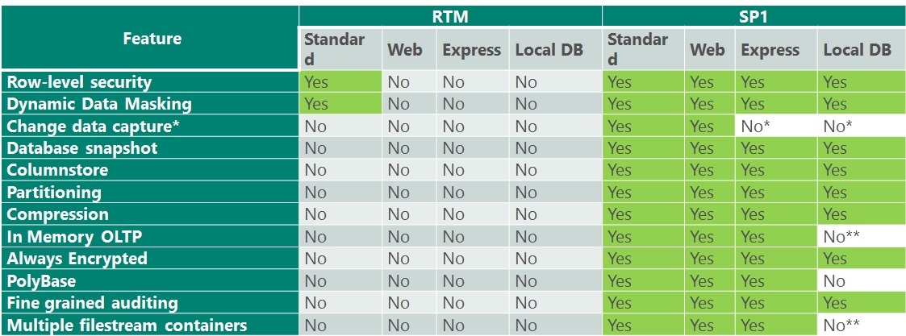
SQL Server 2016 SP1
https://blogs.msdn.microsoft.com/sqlreleaseservices/sql-server-2016-service-pack-1-sp1-released/
https://docs.microsoft.com/en-us/sql/sql-server/editions-and-components-of-sql-server-2016

Slide 9
Foreign Keys and Indexes
Used to link two tables together
A field or collection of fields in one table that refers to the Primary Key in the other one
Used to speed up performance of queries
Avoids reading/scanning unnecessary data

Slide 10
Demo

Slide 11
Foreign Keys and Indexes
Always create Foreign Keys!
Remember to create them with the CHECK CONSTRAINTS
Always Index the Foreign Key column!

Slide 12
Designing matters & Designing Good Indexes
Clustered Indexes
Always create them first!
Avoid them on frequent updated columns
Avoid creating with too many columns! They also impact your NonClustered Indexes
Keep them narrow
If possible use always growing values
NonClustered Indexes
Best when you want to retrieve small number of rows!
The higher selectivity the better!

Slide 13
Designing matters & Designing Good Indexes
Primary Keys
Relational Integrity
Clustering Keys
Internal Mechanism for easily finding rows
Primary Keys not necessarily needs to be the Clustering Key

Slide 14
Demo

Slide 15
Why Stored Procedures are a good idea?
Avoid SQL Injection!
If written in the right way!
Enable plan reuse
Optimization of Plan Cache
Good for processing large amounts of data

Slide 16
Demo

Slide 17
Table Variables & Temporary Tables
Table Variables
Used to hold temporary result sets
No statistics maintained
Indexes cannot be created
Better usage for small workloads
You can only refer them within their scope

Slide 18
Table Variables & Temporary Tables
Temporary Tables
Used to hold temporary result sets
Statistics maintained
Indexes can be created
Good if you have to handle medium sized or big workloads
Depending the creation, can be accessed outside of the batch scope

Slide 19
Demo

Slide 20
Maintaining Indexes
How do I know if they are being used?
Do I have too many indexes in my Database?
Remember. Indexes are hard to maintain
What about missing indexes?

Slide 21
Demo

Slide 22
Speeding up data load
Sometimes the best to do is just remove the indexes
What is the purpose of the data load?
When I would use HEAP Tables?
Heaps can be great for high-performance data load and staging tables.

Slide 23
Demo

Slide 24
Looking for more resources?
https://www.sqlskills.com/blogs/kimberly/
https://sqlperformance.com/author/paulwhitenzgmail-com
https://www.red-gate.com/simple-talk/author/fabiano-amorim/
http://www.benjaminnevarez.com/
https://sqlserverperformance.wordpress.com/

Slide 25
Thank you!
Děkuji mnohokrát!
Dankeschön!
https://goo.gl/B4pWFG
http://marcosfreccia.wordpress.com

